Slide 1
The Leadership Challenge of Our Lifetime
Understand the Impending Crisis

Slide 2
Matt Bennett, MA, MBA
matt@BIGL3C.org
Leadership is a journey
Acknowledging our current trauma
Format
Understand the Impending Crisis
Importance of Organizational Support & Recovery Plan

Slide 3
What is happening to us?

Slide 4
Leading Professions for Burnout
Physicians
Nurses
Social work/social services
Teachers
Principals
Lawyers
Police officers

Slide 6
Connecting Stress to Outcomes

Slide 7
Job Demand-Resource Model
Negative Outcomes
Job Demands
Positive Outcomes

Slide 8
Job Demands
Physical, social, emotional, or organizational aspects of a job that require sustained effort are associated with certain physiological and psychological costs
Notes:
*took out the “and”

Slide 9
Managing Job Demands

Slide 10
Expectations During Recovery
Changing priorities
Transitioning to a “new normal”
Help reestablish work/life balance
Redefining “self-care”
Focus on the Shared in Shared Expectations!

Slide 11
Job Demand-Resource Model
Negative Outcomes
Job Demands
Job Resources
Positive Outcomes

Slide 12
Job Resources
Physical, social, emotional, or organizational aspects of the job that may do any of the following
Reduce job demands and the associated physiological and psychological costs
Be functional in achieving work goals
Stimulate personal growth and development

Slide 13
Job Demand-Resource Model
Helping Fatigue
Negative Outcomes
Job Demands
Declining Health
Job Resources

Slide 14
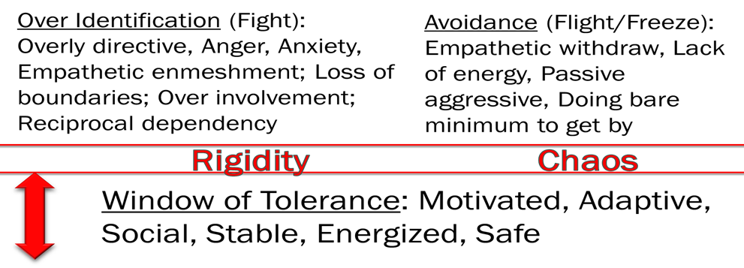
Cup Analogy
Managing the streams
Job demands (empathetic intensity, moral distress, workload)
Personal life
Stress intensifiers
Duration
Uncertainty
Importance
Traumatic Event - Events involving intense stress that overwhelms the nervous systems capacity to cope. Results in an existence dominated by the trauma for a period of time.
Chronic Trauma - Living in high stress environment and in the shadow of the threat of traumatic events occurring at any time.

Slide 15
job Demand > Job Resources
Compassion Fatigue
When empathetic intensity fills up the helper's cups capacity
Vicarious Trauma
Witnessing a person’s traumatic experience and the resulting empathetic intensity
Secondary Trauma
Something about the person’s trauma connects with something in helper’s personality or past experience
Moral Injury
Accumulation of the negative psychological impact of morally distressing situations
Burnout
Workload overwhelms capacity to do the work with desired level of quality

Slide 16
Supporting Staff Self-care

Slide 17
Self-care
Reactive
Proactive
Helping Fatigue
Negative Outcomes
Job Demands
Declining Health
Job Resources

Slide 18
Stages of Helping Fatigue
Proactive Self-care
Reactive Self-care
Exhaustion
Cynicism & Callousness
Crisis
Shame, Doubt, & Guilt
Healthy, Motivated, & Engaged

Slide 19
Impact of Helping Fatigue
Physical Health
Social/Work Health
Mental Health
Social Isolation
Relationship Issues
Poor Performance
Absenteeism
Tardiness
Theft
Dehumanization of Patients
Turnover (at least 40% is stress related)
Grievances
Litigation
Low Job Satisfaction
Cardiovascular Disease
Stroke
Type II Diabetes
Musculoskeletal Disorder
Cancer
Physical Fatigue
Sexual Issues
Gastrointestinal Problems
Headaches
Physical Illness
Back Problems
PTSD
Memory Loss & Cognitive Decline
Sleep Problems
Headaches
Mental Fatigue
Anxiety & Irritability
Depression
Aggression
Defensiveness
Negative World View & Hopelessness
Negative Attitude

Slide 20
YOU ARE THE ROLE MODEL FOR STAFF SELF-CARE AND WELLNESS

Slide 21
The Leadership Challenge of Our Lifetime
Importance of Organizational Support & Recovery Plan

Slide 22
Job Demands > Job Resources + Self-care = Negative Outcomes
Job Demands < Job Resources + Self-care = Capacity for Engagement
Self-care
Proactive
Reactive
Helping Fatigue
Negative Outcomes
Job Demands
Declining Health
Job Resources
Engagement
Positive Outcomes
Motivation

Slide 23
Positioning Supportive Supervision to Offset Job Demands

Slide 24
This can not be our reality
75% report that their supervisor is the most stressful part of their job
27% state being bullied by their boss
24% would fire their boss
The worst part of the day = time spent with boss
Those who work for 'bad' bosses have a 39% higher chance of having a serious heart problem
77% of leaders believe that their staff are not giving 100%
73% of workers state they are not giving 100%

Slide 25
Job Demand-Resource Model
Helping Fatigue
Negative Outcomes
Job Demands
Declining Health
Job Resources
Engagement
Positive Outcomes
Motivation

Slide 26
Supportive Supervision Co-regulation
Relational support and staff health
Understand stress level and helping fatigue
Time to build trust and safety
Dedicated time to connect

Slide 27
Supportive Supervision Structure
Wellness
Professional development
Administrative

Slide 28
Trauma-Informed Human Resource Strategies

Slide 29
Job Demand-Resource Model
Helping Fatigue
Negative Outcomes
Job Demands
Declining Health
Job Resources
Engagement
Positive Outcomes
Motivation

Slide 30
Time Off
Encourage disconnecting from work communications after hours and vacations
Ensure access to family leave and bereavement
Celebrate those who use their paid time off – be the role model
Power of 2-week vacations

Slide 31
Therapy
Trauma-informed organization provide access to free therapy
Leadership needs to role model the use of therapy for self-care and be able to discuss the process
Notes:
Added “s” to need

Slide 32
Positioning a Healthy Culture as a Crucial Job Resource

Slide 33
Job Demand-Resource Model
Helping Fatigue
Negative Outcomes
Job Demands
Declining Health
Job Resources
Engagement
Positive Outcomes
Motivation

Slide 34
Team/Organizational Culture
The way staff work together and the set of beliefs and values that guide behavior and decision making

Slide 35
Program/Organizational Climate
How the people experience the program or organization including the physical space, processes, and staff

Slide 36
Promoting Engagement to Improve Outcomes

Slide 37
Job Demand-Resource Model
Helping Fatigue
Negative Outcomes
Job Demands
Declining Health
Job Resources
Engagement
Positive Outcomes
Motivation

Slide 38
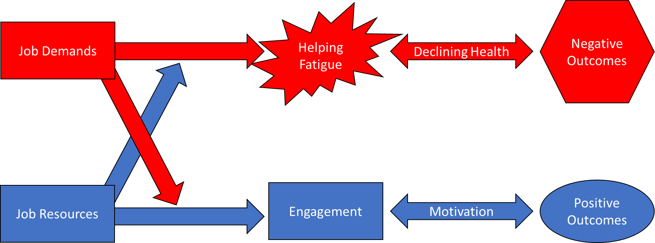
Engagement
Positive, fulfilling, work-related state of mind that is characterized by grit (passion and perseverance) and dedication (importance, pride, and challenge)

Slide 39
Lack of Engagement
“Actively disengaged employees erode an organization's bottom line while breaking the spirits of colleagues in the process. Within the U.S. workforce, Gallup estimates this cost to be more than $300 billion in lost productivity alone. In stark contrast, world-class organizations with an engagement ratio near 8:1 have built a sustainable model…As organizations move toward this benchmark, they greatly reduce the negative impact of actively disengaged employees while unleashing the organization's potential for rapid growth.” – Gallup

Slide 40
Positive Regard
Positive Regard – Relationships built upon optimism, trust, caring and investment in another’s future success
Whether or not staff feel that leaders care about their well-being is the #1 predictor of organizational engagement
Only 38% of workers feel this is true of their leaders
50% felt their well-being didn’t matter at all to their leaders
Only 10% felt like they were a vital asset to the organization

Slide 41
Positive & Growth Mindsets
“This growth mindset is based on the belief that your basic qualities are things you can cultivate through your efforts. Although people may differ in every which way…they believe that a person’s true potential is unknown (and unknowable); that it’s impossible to foresee what can be accomplished with years of passion, toil, and training.” -Carol Dweck
Leaders help find hidden strengths and new challenges to promote engagement
20-Mile March

Slide 42
Democracy & Collaborative Decision Making
Defining a community
Staff engagement
Empowering those in services
Shifting power and information down the organizational chart
Engagement and choice

Slide 43
Shared Vision
The leader connects the future direction of the organization to the passion of the staff and the mission of the organization
Shared values are the means-the shared vision is the end
When futures are shared:
Attracts more people
Sustain higher levels of motivation
Withstand more challenges

Slide 44
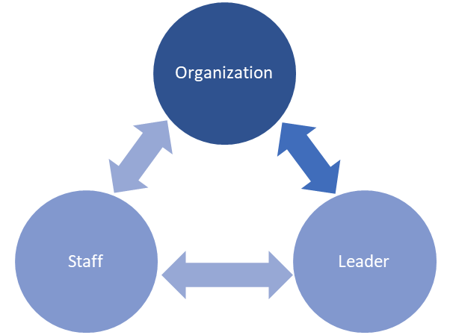
Shared Values
“Deeply held values help us to avoid being whipsawed by whatever winds happen to be blowing around us. Values provide an internal source of direction for our behaviors.” Tony Schwartz
Leader’s job
Connect their values to that of the organization
Help staff identify their personal values
Connect staff’s personal values to that of the organization
When values conflict morale safety suffers
Notes:
Added an apostrophe s to staff

Slide 45
Impact of Shared Values
Revenues increased 4X
Stock prices grew five times faster
Profit performance was 750% higher
Job creation increased by 7X
Increased engagement
Facilitate consensus on key organizational goals
Better understanding of job expectations
Increased personal and team effectiveness
High levels of organizational loyalty and pride
Decrease in turnover and burnout

Slide 46
Accountability Fallacy
“Captures a common mistake people make when they assume that others fail to follow through because there is something wrong with them…When leaders fall prey to the Accountability Fallacy, they not only assume that their people are flawed, but that they themselves can do little or nothing to change those flaws except punish people for having them."
- Connors & Smith

Slide 47
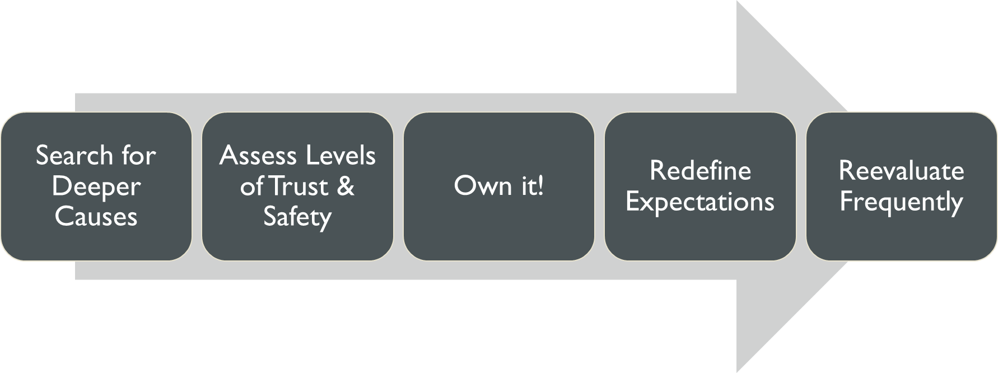
Trauma-Informed Accountability

Slide 48
Impact of Recognition
High performers (individuals and teams) are shown to get 5.6 times more positive feedback than negative
Low performers get 2.8 times more negative feedback than positive
High Recognition Environment
39% Increase in staff satisfaction
73% Increase in morale
64% Increase in engagement
45% Increase in loyalty
20% increase in productivity
20% increase in revenue

Slide 49
Impact of Recognition
Alignment with Shared Values and Vision.
Reinforce growth mindset by recognizing behaviors
Make it meaningful
Invite important people
Customize it to the staff
Make it timely
Let employees recognize employees

Slide 50
Matt Bennett, MA, MBA
matt@BIGL3C.org
Assessments
Professional Quality of Life: https://proqol.org/
Gallup 12: https://www.gallup.com/access/323333/q12-employee-engagement-survey.aspx
Keep Learning: Get a free book at optimalhrv.com
Thank you for all your work!

